Slide 1
Supermarket Sales Prediction
Jui Ashinkar
NUID:001443824

Slide 2


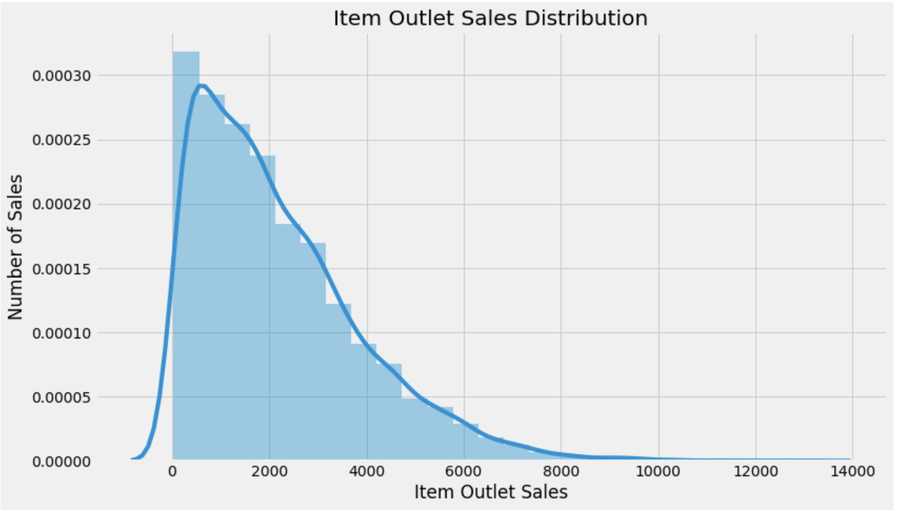



Histogram shows the Distribution of Numeric Variables

Slide 3
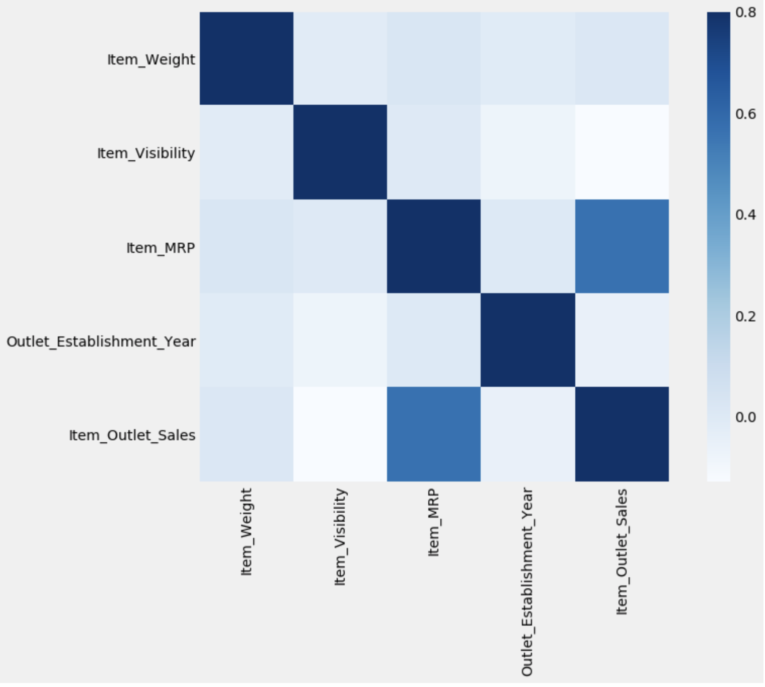
Correlation Matrix of numerical predictors and our target variable

Slide 4
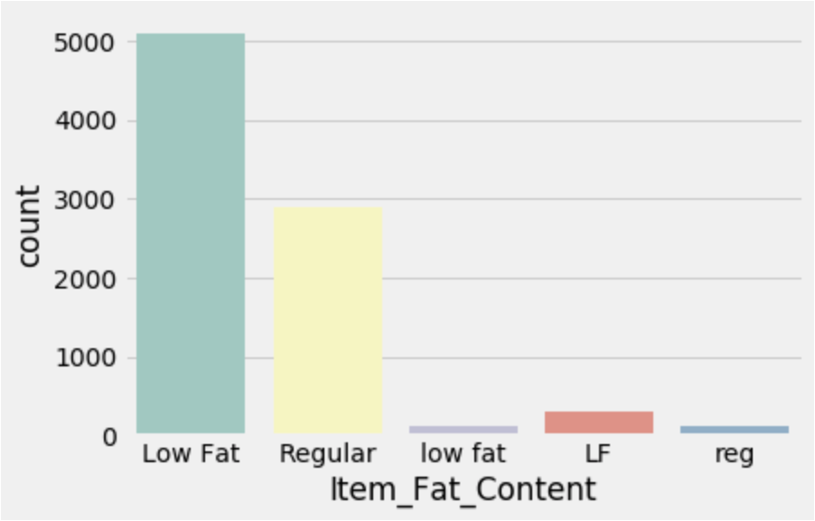
Naming Error in Types of Fat Contents

Slide 5
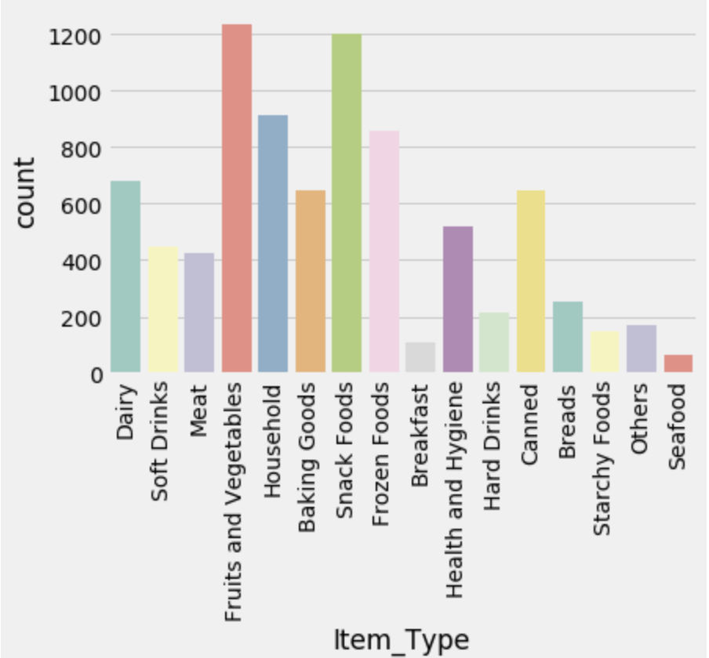
16 Item types of Categorical Variables and their count

Slide 6
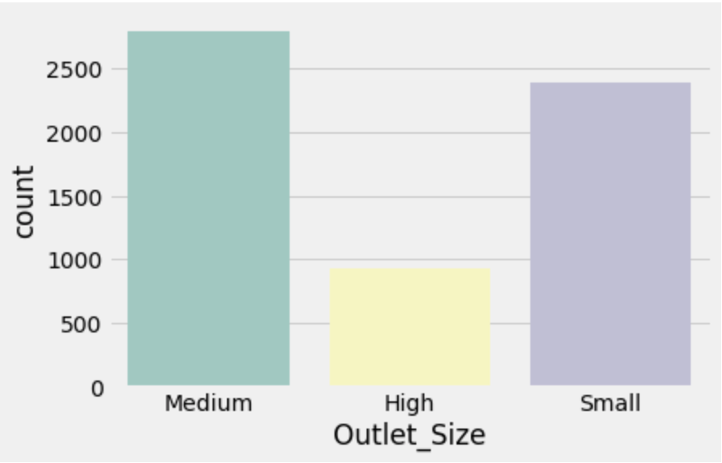
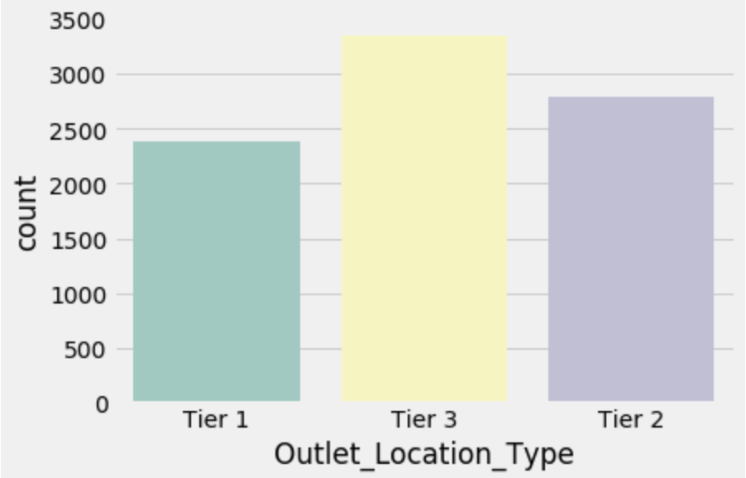
Number of Outlets based on Size and Location

Slide 7
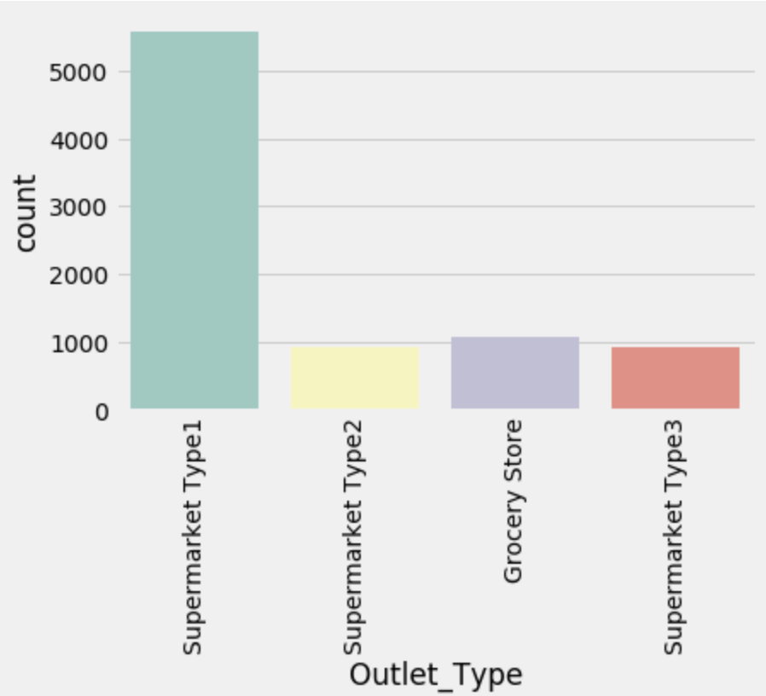
Count of the 4 Outlet Types

Slide 8
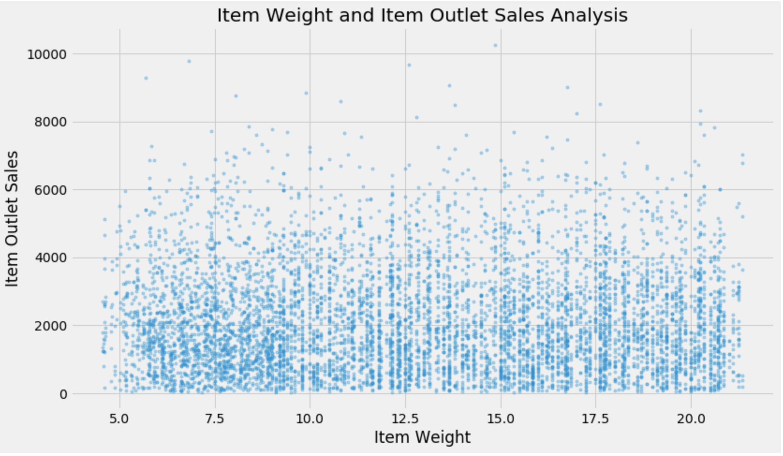
Relationship between the correlation of Item weight and Item Outlet Sales

Slide 9
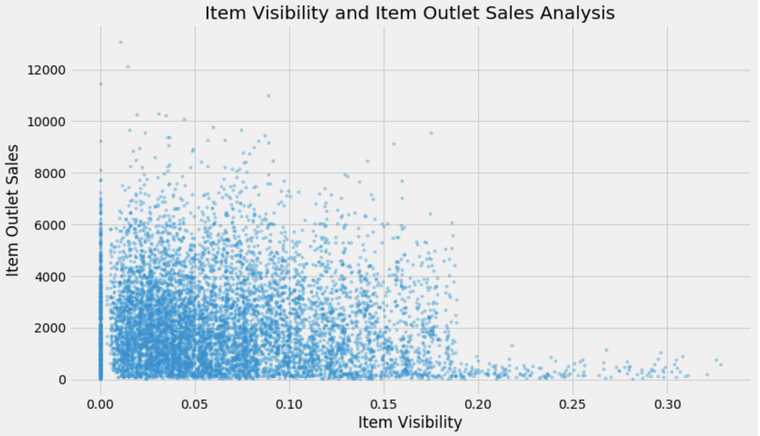
Relationship between the correlation of Item Visibility and Item Outlet Sales

Slide 10
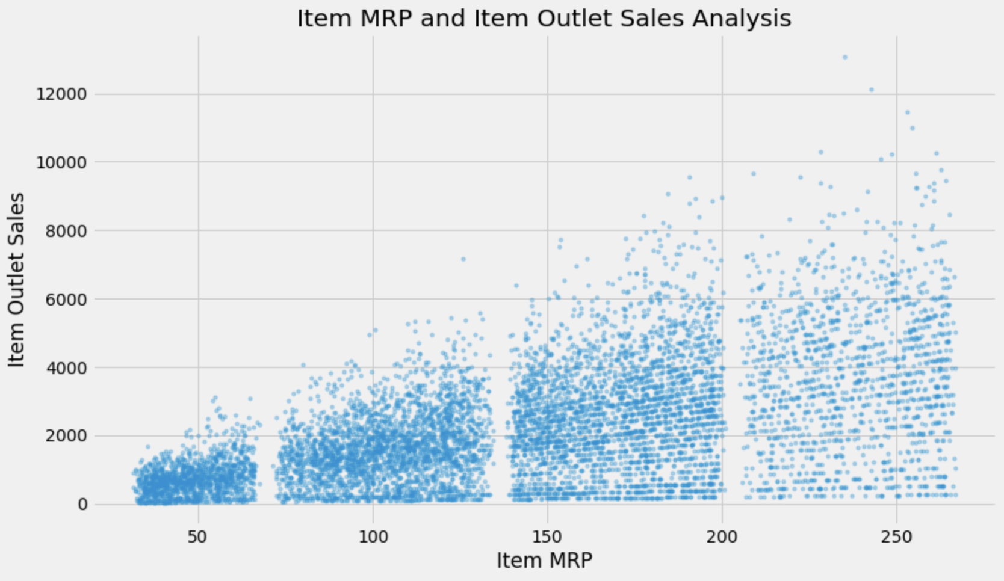
Bivariate Distribution of the Item_MRP and target variable

Slide 11
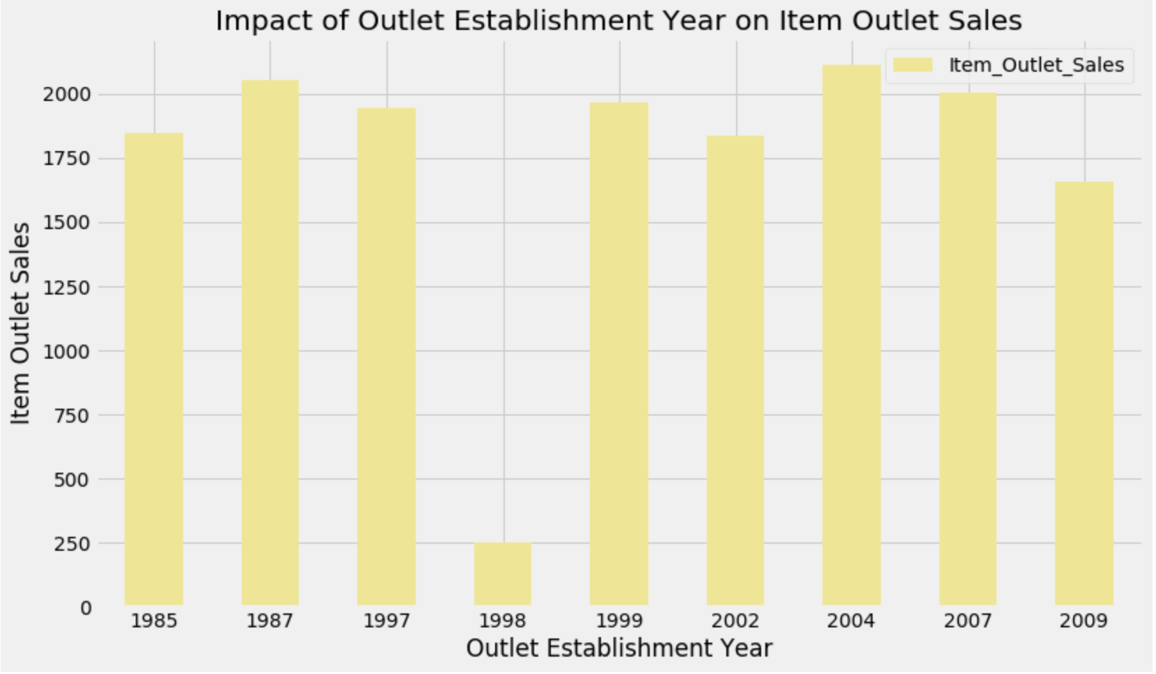
Outlet Establishment Year and Item Outlet Sales Analysis

Slide 12
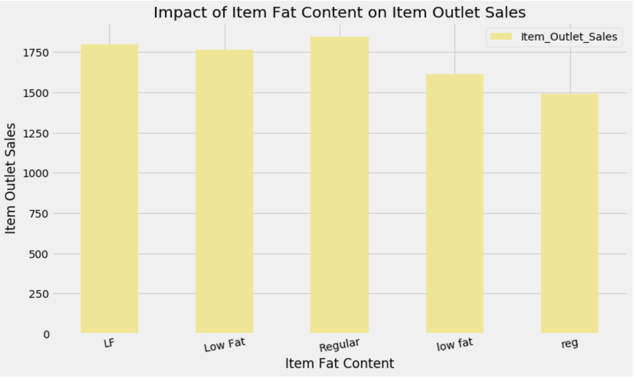
Impact of Item Fat Content on Item Outlet Sales

Slide 13
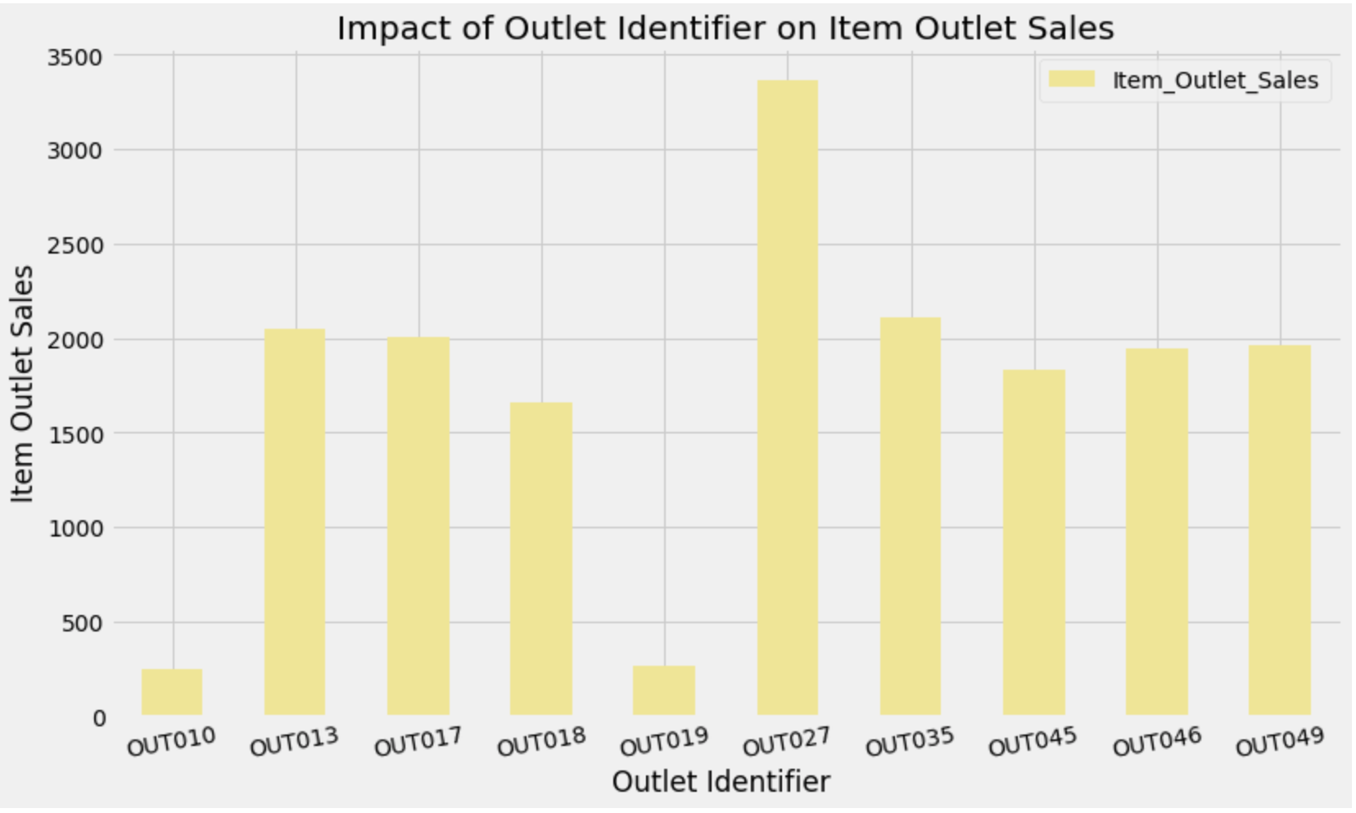
Impact of Outlet Identifier on Item Outlet Sales

Slide 14
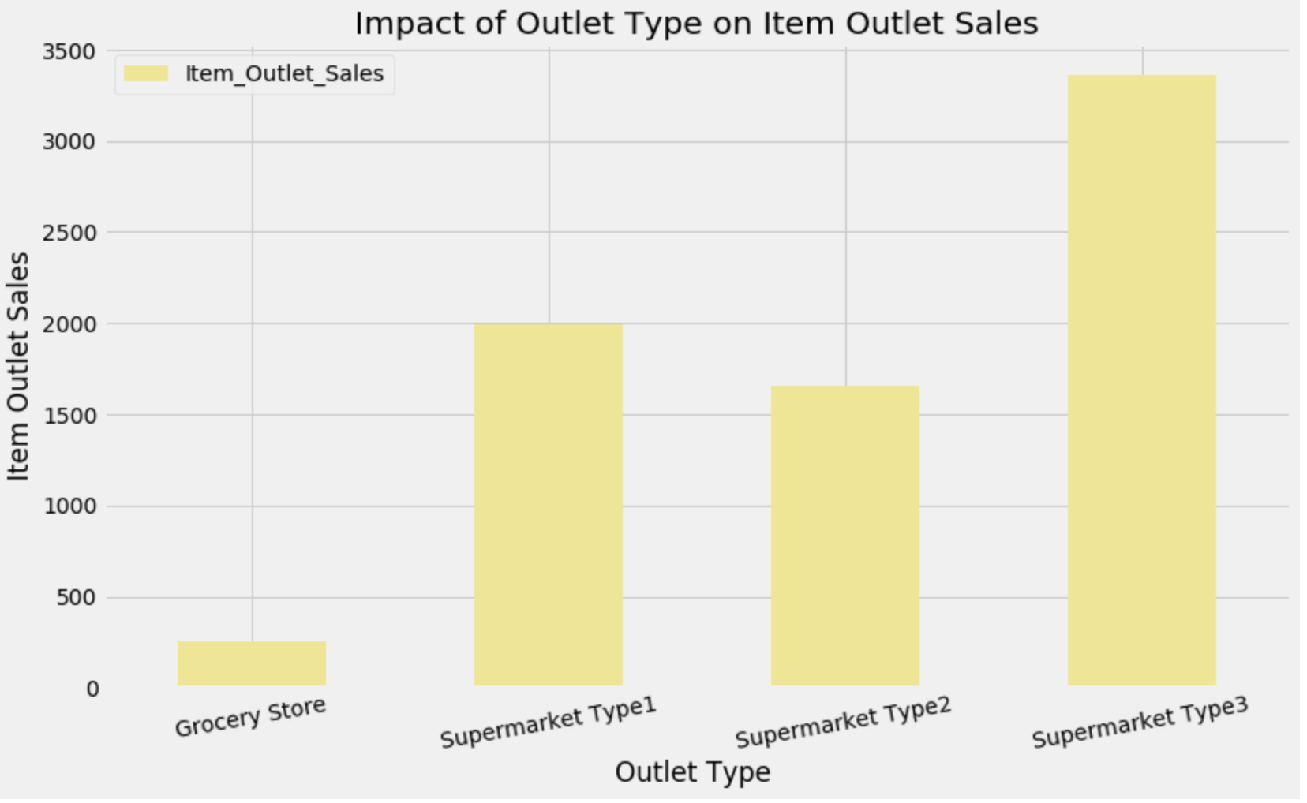
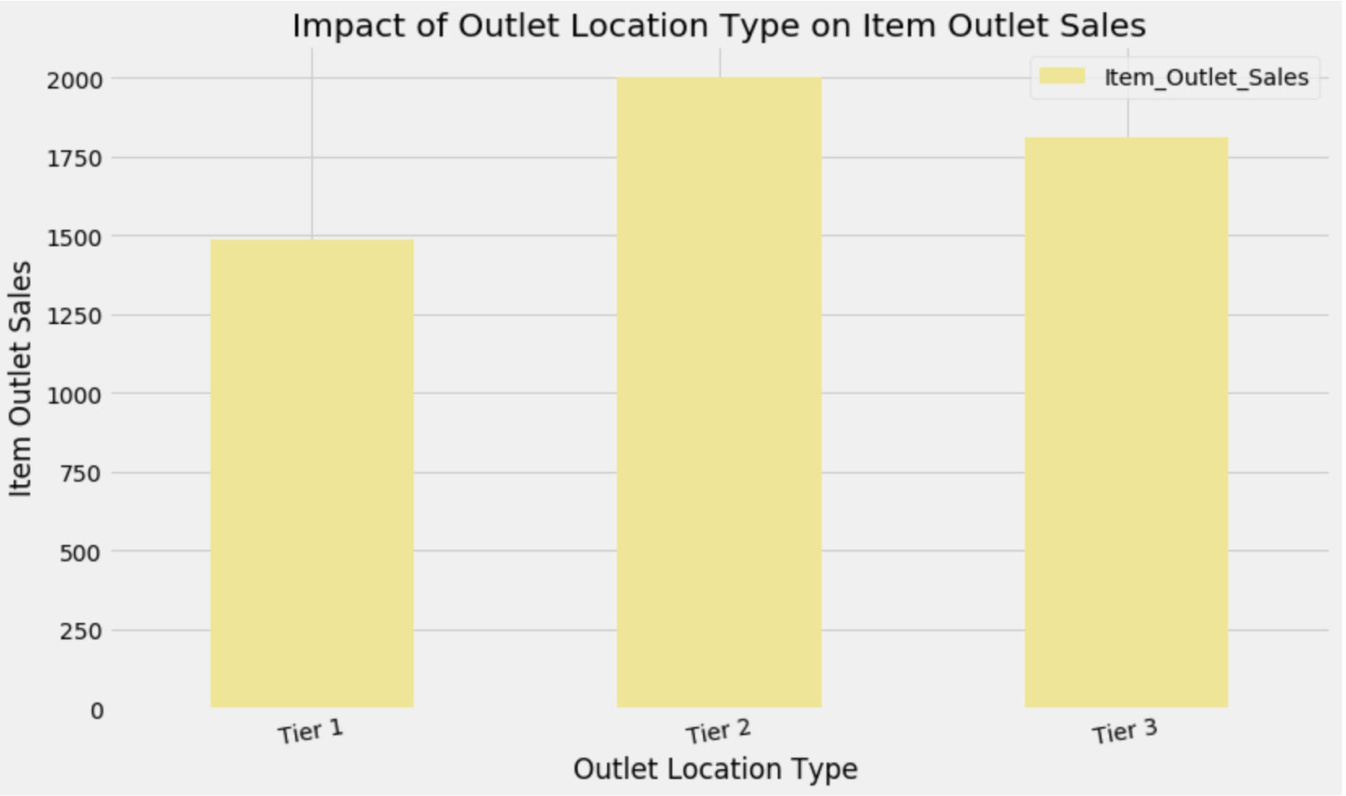
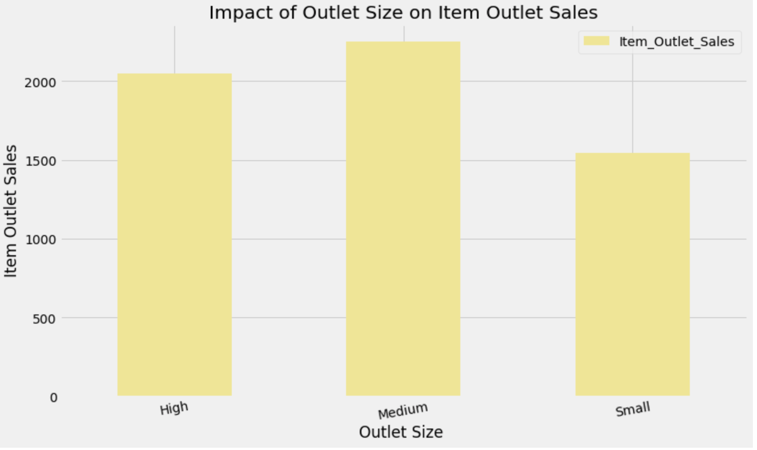
Impact of Outlet Type, Outlet Size, Outlet Sales on Item Outlet Sales

Slide 15
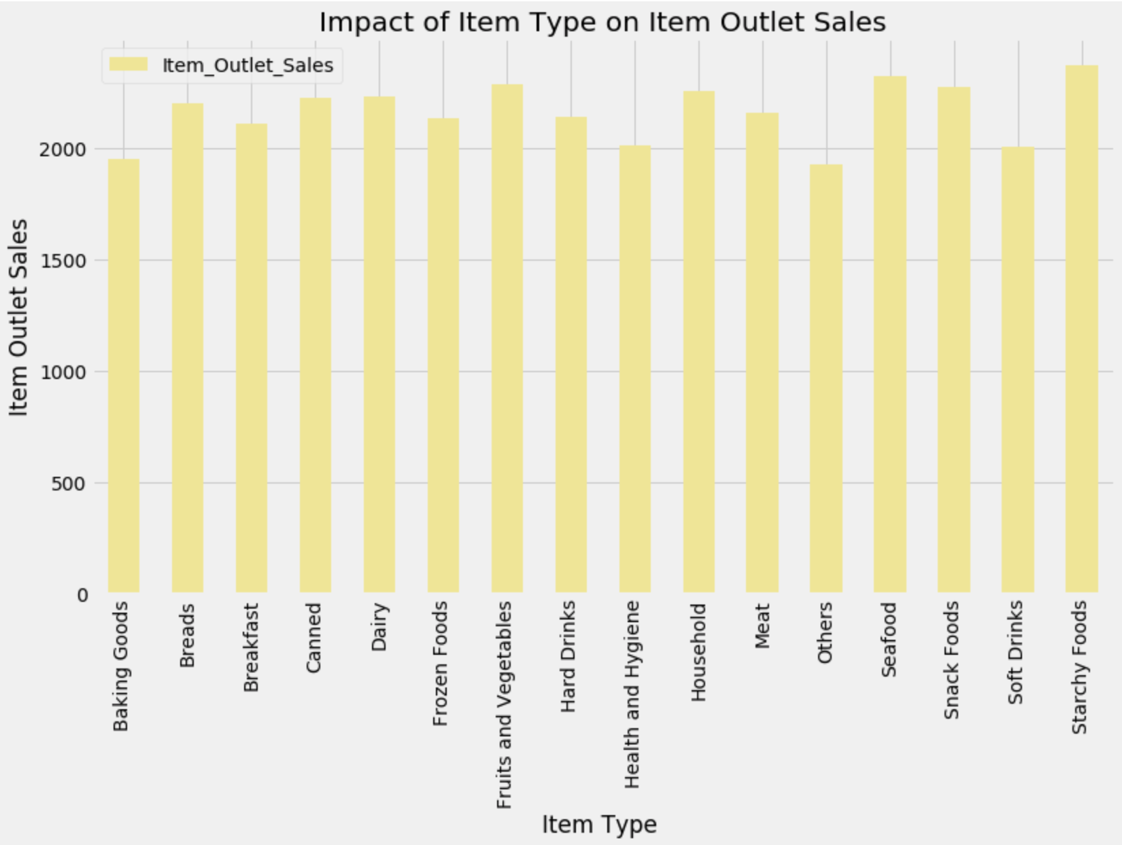
Impact of Item_Type on Item_Outlet_Sales

Slide 16
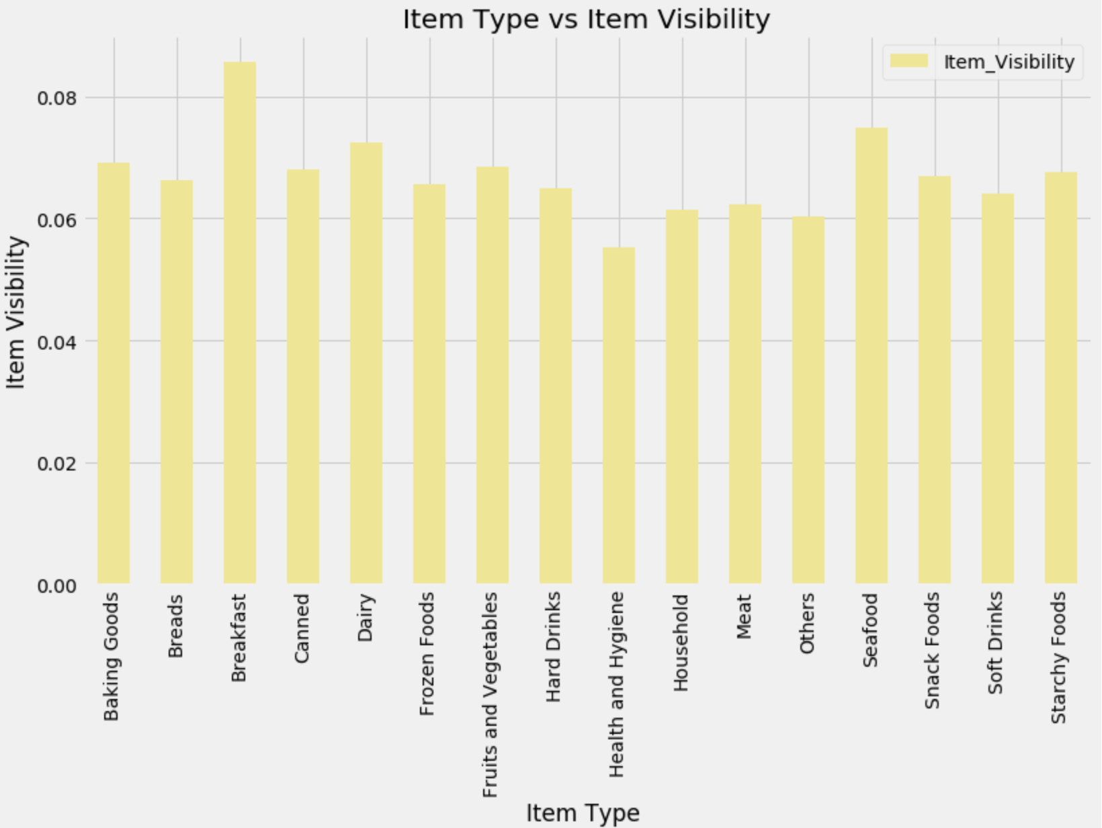
Impact of Item_Type vs Item_Visibility

Slide 17
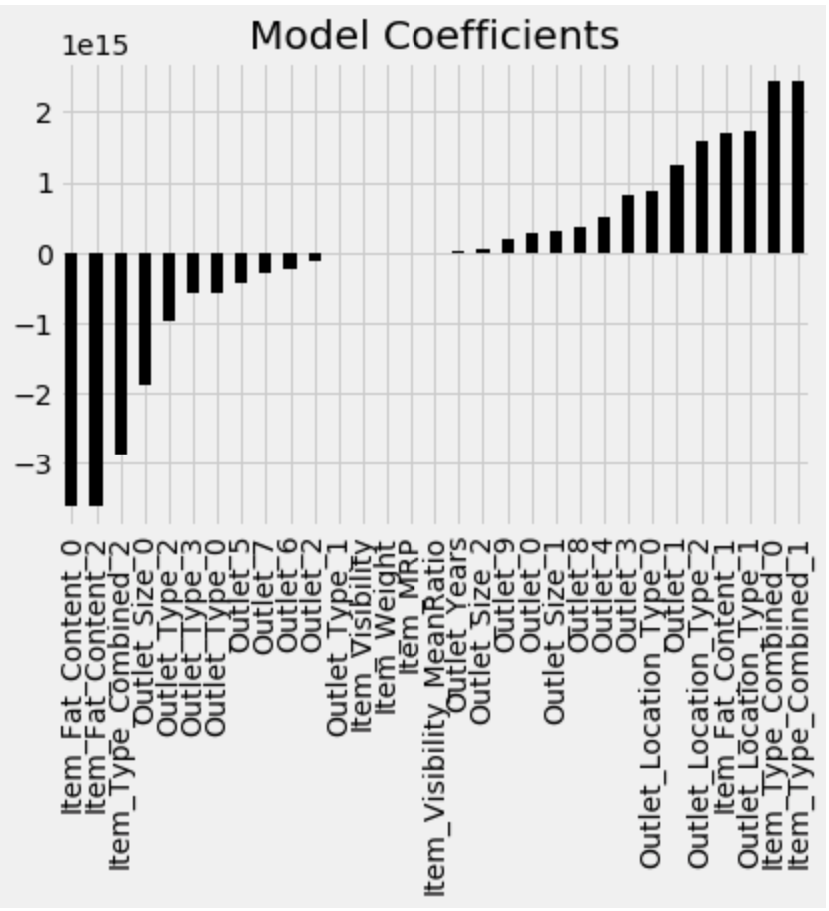
Model coefficients of Linear Regression

Slide 18
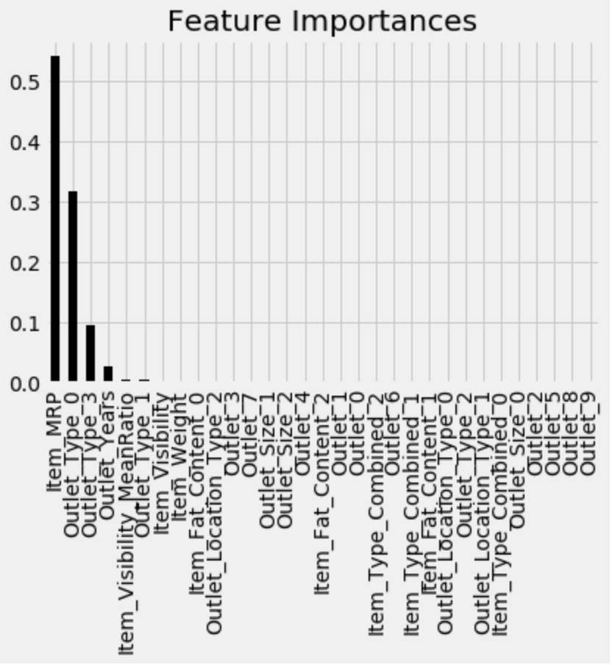
Feature Importance Using Decision Tree Regressor

Slide 19
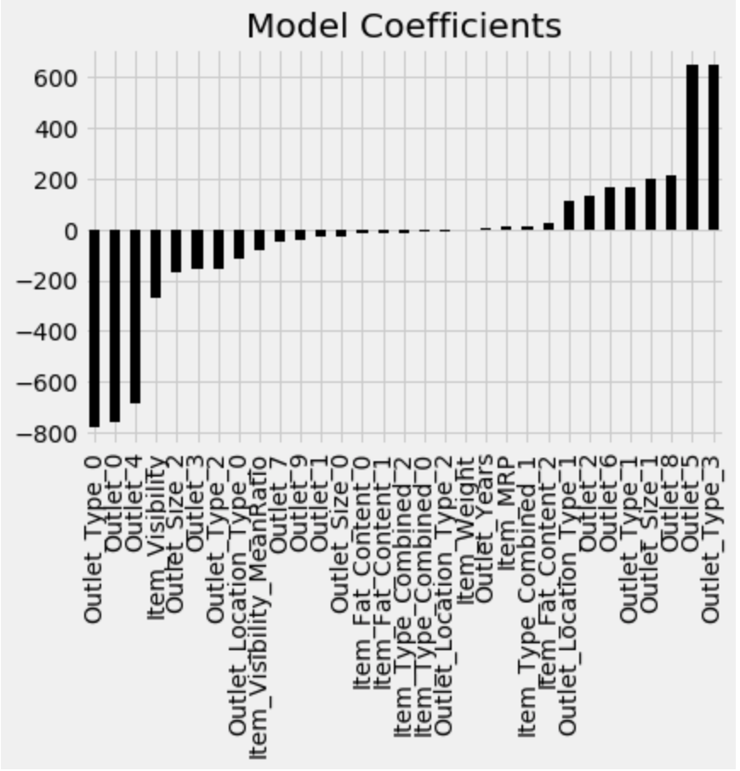
Model coefficients of Ridge Regression

Slide 20
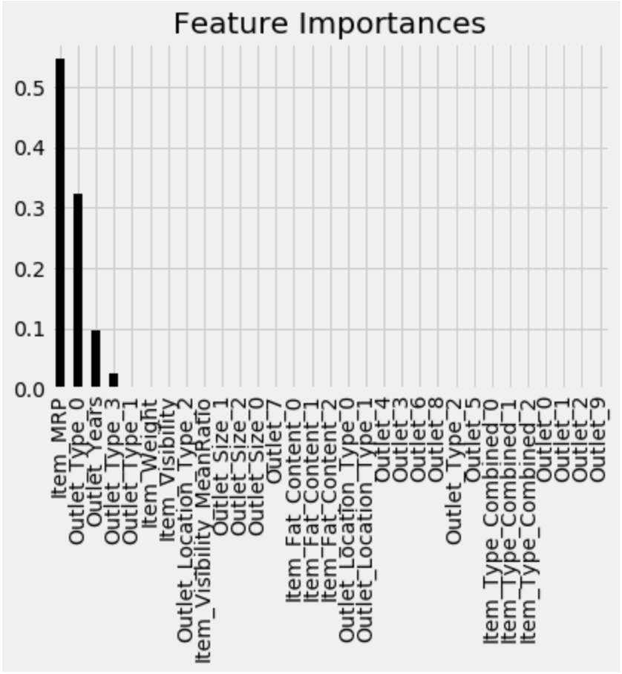
Feature Importance Using XGBoost Regressor

Slide 21




Thank You

